Slide 1
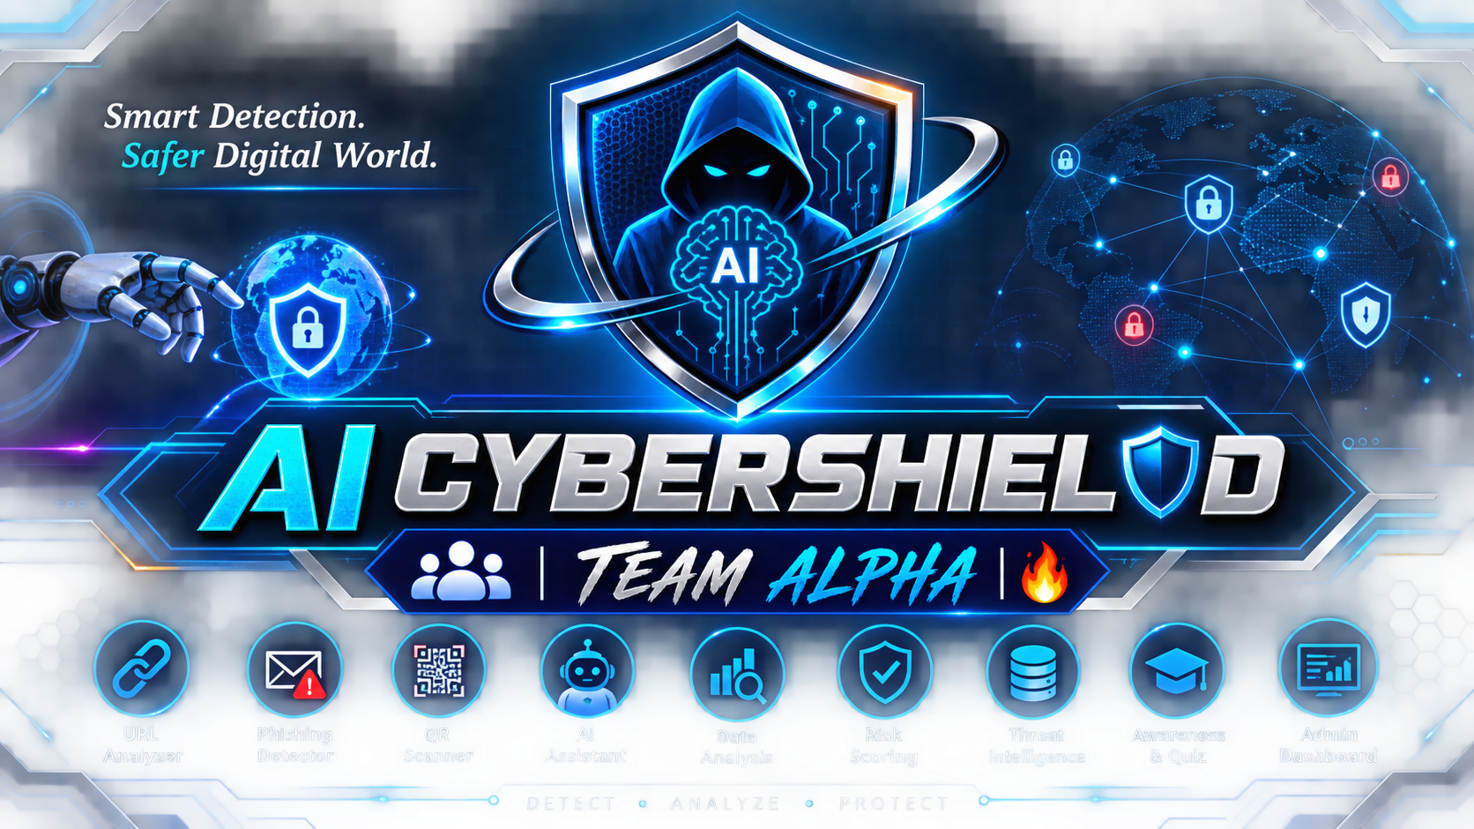
AI CYBERSHIELD | TEAM ALPHA 🔥
AI-Powered Digital Threat Detection & Cyber Safety Platform
5-Member Group • 3 Cybersecurity + 2 Data Analysis • Competition Project

Slide 2
1. Why are we building this?
Problem → Solution mindset
•
Users regularly encounter phishing links, fake websites, scam messages and malicious QR codes.
•
A normal user may not know whether a digital message or link is safe.
•
Existing security tools can be difficult for non-technical users to understand.
•
Our project combines detection with a simple explanation and safety recommendation.
AI CyberShield • Project Planning | 2

Slide 3
2. What is AI CyberShield?
INPUT
ANALYZE
SCORE
EXPLAIN
PROTECT
URL / Message / QR
→
Security + AI signals
→
Risk level + evidence
→
Why is it risky?
→
Recommended action
Key idea: the system should not only say “dangerous”; it should explain the evidence behind the assessment.
AI CyberShield • Project Planning | 3

Slide 4
3. Main Features
The project is a platform, not a single detector.
URL Threat Analyzer
Phishing Message Detector
QR Security Scanner
Analyze URL characteristics and threat indicators.
Identify suspicious language, links and social-engineering signals.
Extract a QR URL and pass it through the threat pipeline.
AI Cyber Assistant
Risk Scoring Engine
Threat Dashboard
Explain threats and answer cybersecurity questions.
Combine multiple indicators into an understandable risk level.
Show scan history, trends, categories and risk distribution.
Cyber Awareness
Admin & Security
Quizzes and learning content on common attacks.
Role-based access, logs, validation and administration.
AI CyberShield • Project Planning | 4

Slide 5
4. Feature Deep Dive — URL Threat Analyzer
USER ACTION
SYSTEM ANALYSIS
Enter a suspicious URL.
Example:
https://example.com/login
• URL structure
• HTTPS / protocol signals
• Suspicious patterns
• Domain-related signals
• Reputation / threat-intelligence evidence where available
• Other engineered security features
Output: Risk score + risk level + evidence + safety recommendation
AI CyberShield • Project Planning | 5

Slide 6
5. Feature Deep Dive — Phishing Message Detector
INPUT
INDICATORS
Paste an SMS, email or suspicious message.
• Urgency / pressure
• Fake reward or threat
• Credential requests
• Payment requests
• Suspicious links
• Social-engineering language
Result example: “Likely Phishing” + reasons + recommended action
AI CyberShield • Project Planning | 6

Slide 7
6. Two “Wow” Features
📷 QR SECURITY SCANNER
🤖 AI CYBER ASSISTANT
Scan QR
↓
Extract URL
↓
Run URL threat analysis
↓
Show risk + recommendation
Ask:
“Why is this suspicious?”
“How do I stay safe?”
“What is phishing?”
AI gives a simple explanation.
AI CyberShield • Project Planning | 7

Slide 8
7. Risk Scoring Engine
LOW
MEDIUM
HIGH
CRITICAL
Lower-risk signals
Needs caution
Strong warning signs
Very strong threat evidence
Important: the score is an assessment, not a 100% guarantee. We will test and calibrate the model/logic using evidence and evaluation metrics.
AI CyberShield • Project Planning | 8

Slide 9
8. Where Data Analysis fits
DATA COLLECTION
DATA CLEANING
FEATURE ANALYSIS
Store scan outcomes, indicators and categories safely.
Remove duplicates, handle missing values and prepare data.
Find which signals correlate with suspicious outcomes.
VISUALIZATION
MODEL EVALUATION
Charts for threat types, risk distribution and trends.
Measure precision, recall, F1-score and false positives.
AI CyberShield • Project Planning | 9

Slide 10
9. Where Cybersecurity fits
•
Threat modeling: define what the platform must defend against.
•
Authentication & authorization: separate user and admin privileges.
•
Input validation: never trust user-controlled input.
•
Password security: store password hashes, never plain-text passwords.
•
API security: rate limiting, access control and secure error handling.
•
Logging & monitoring: record important security events without exposing secrets.
•
Security testing: test misuse, invalid input, unauthorized access and abuse cases.
AI CyberShield • Project Planning | 10

Slide 11
10. High-Level Architecture
Frontend
Web UI • Dashboard • QR scanner
Backend API
Authentication • Validation • Business logic
Detection Layer
URL analyzer • Message analyzer • QR pipeline
AI / Data Layer
NLP/ML • Feature engineering • Risk scoring
Data & Intelligence
Database • Scan history • Threat intelligence
AI CyberShield • Project Planning | 11

Slide 12
11. Team Roles — 5 Members
Member 1 — Cybersecurity Core
Threat modeling • URL/message analysis • security controls
Member 2 — Cybersecurity Engineering
Authentication • Authorization • Secure APIs • Testing
Member 3 — Cybersecurity + Integration
Threat intelligence • Security testing • Module integration
Member 4 — Data Analysis / ML
Dataset • Cleaning • Features • Model evaluation
Member 5 — Data Analysis / Dashboard
Visualization • Analytics • Dashboard • Reporting
AI CyberShield • Project Planning | 12

Slide 13
12. Suggested Technology Stack
Frontend
HTML • CSS • JavaScript
React (optional)
Backend
Python + FastAPI
REST APIs
Data / AI
Python • pandas
scikit-learn • NLP
Database
PostgreSQL or MySQL
Security
Argon2id/bcrypt
JWT/session • validation
Tools
VS Code • Git/GitHub
Postman • Docker (optional)
AI CyberShield • Project Planning | 13

Slide 14
13. Development Roadmap — Target: ~60 Days
Days 1–10
Requirements • UI • Architecture
Days 11–20
Database • Backend • Authentication
Days 21–32
URL + Message Detection
Days 33–40
QR Scanner + Risk Engine
Days 41–48
AI/ML + Assistant + Dashboard
Days 49–55
Security Testing + Integration
Days 56–60
Documentation • PPT • Demo • Viva
AI CyberShield • Project Planning | 14

Slide 15
14. Competition Demo Flow
1. Open CyberShield
Landing / dashboard
2. Scan URL
Analysis + risk score
3. Phishing Message
Indicators + explanation
4. Scan QR
QR → URL → analysis
5. Ask AI Assistant
Explain the threat
6. Open Dashboard
Analytics + threat trends
LIVE DEMO SEQUENCE
Input → Detection → Risk Score → Explanation → Recommendation
AI CyberShield • Project Planning | 15

Slide 16
15. Testing Strategy
Functional Testing
Valid/invalid URLs, messages, QR inputs and user flows.
Security Testing
Unauthorized access, injection attempts, auth abuse and rate limits.
Model / Data Testing
Precision • Recall • F1-score • confusion matrix • false positives.
Usability Testing
Clear results, understandable explanations and responsive UI.
Integration Testing
Verify frontend, backend, AI/ML and database work together.
AI CyberShield • Project Planning | 16

Slide 17
16. Final Deliverables
Working Platform
End-to-end demo
Source Code
Organized repository + README
Database
Schema + test data
Project Report
Architecture + testing + results
PPT
Competition presentation
Demo Script
Fixed sequence + backup plan
Viva Prep
Technical + project questions
Future Scope
Post-college roadmap
AI CyberShield • Project Planning | 17

Slide 18
17. Future Scope
Mobile App
Android / iOS version
Browser Extension
On-page URL warnings
Threat Intelligence
More security-data integrations
Multilingual Analysis
Broader phishing-message support
Model Improvement
Continuous evaluation + retraining
Organization Analytics
Privacy-aware college/company dashboards
AI CyberShield • Project Planning | 18

Slide 19
AI CYBERSHIELD
Detect • Analyze • Explain • Protect
Our goal is not just to build a college project.
We want to build a security-focused product that demonstrates
Cybersecurity + Data Analysis + AI in one working system.
Next step: finalize scope → assign modules → choose stack → start development
Thank You

